Slide 1

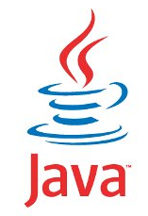
JAVA SE
(Core java)
Lecture 1 –Part 2

Slide 2

Today’s Agenda
An Introduction to JAVA
Important Features

Slide 3
Important Features
Platform Independent
Automatic Memory Management
Secure
Robust
Simple
Object Oriented
Multithreaded

Slide 4
Important Features
Platform Independent
A platform is the environment in which an application
runs.
In other words it is the combination of an OS and a CPU.
For example:
Windows 8+Intel - Core i5 (is a diff. platform)
Linux + AMD -A6(is another diff platform)
Mac + Intel -Core i3(is yet another diff platform)

Slide 5
Important Features
Now being platform independent means that an application developed and compiled over one platform can be executed over any other platform without any change in the code.
And , Java has this capability using the concept of “bytecode” and “JVM”

Slide 6
Important Features
Whenever we compile a java program , the compiler never generates machine code.
Rather it generates a machine independent code called the “bytecode”.

Slide 7
Important Features
This bytecode is not directly understandable by the platform(OS & CPU).
So another special layer of software is required to convert these bytecode instructions to machine dependent form

Slide 8
Important Features
This special layer is the JVM , that converts the bytecode to underlying machine instruction set and runs it.

Slide 9
Important Features
class HelloWorld {
public static void main(String args[ ]) {
System.out.println(“Hello World!”);
}
}
Java Program
Compiler
Interpreter
Interpreter
Interpreter
Hello World!
Hello World!
Hello World!
Win32
Solaris
MacOS
Notes:
Java is Portable
In the past, portability was not as much of a concern as it has become today. Most applications were fairly static in the sense that they were deployed on a consistent platform and did not require a lot of changes and tinkering to keep them running. However, in modern systems it is not at all uncommon for many components to be distributed across various hardware, operating systems, and networks. This heterogeneousness would pose great problems for many languages, but not Java!
Java applications can run practically anywhere. This makes Java quite revolutionary. Essentially anything that has some kind of processor can be Java-enabled, from mainframes to personal computers to telephones and beyond. Java programs are flexible enough to be local applications, web-based applets, server-side applications, and embedded software. The application code does not usually have to be changed to run on these different devices either. This means you can truly write the code once and run it anywhere you wish.
The key to this portability is the interpreted nature of the language. Since code does not have to be compiled to specific platforms, your Java program can be anywhere a JVM exists. The world does not run on one type of platform alone and new platforms are constantly being introduced. By being portable, java programs written today can still be viable tomorrow.

Slide 10
Important Features
Thus any such platform for which a JVM is available can be used to execute a Java application irrespective of where it has been compiled.
This is how java makes itself “Platform Independent” and it also truly justifies java’s slogan of “WORA”(Write Once Run Anywhere)

Slide 11
Important Features
Automatic Memory Management:
In languages like C and C++ any dynamic memory which the programmer allocates using malloc( ) or new has to be deallocated by himself using free( ) or delete
But Java uses runtime automatic garbage collection
feature where the JVM itself deallocates any dynamic
memory which our program allocated.

Slide 12
Important Features
Secure
When it comes to security, Java is always the first choice. It
enables us to develop virus free, tamper free system.
Java is a more secure language as compared to C/C++ because:
It does not allow a programmer to explicitly create pointers.
Java program always runs in Java runtime environment with almost null interaction with system OS, hence it is more secure.

Slide 13
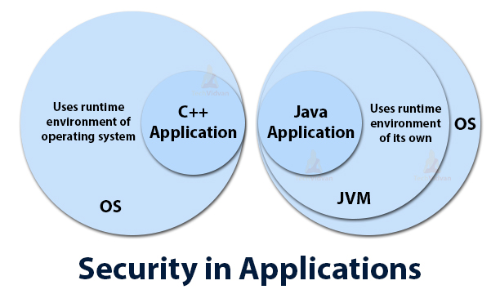
Important Features

Slide 14
Important Features
Robust
Java has very strict rules which every program must compulsorily
follow and if these rules are violated then JVM kills/terminates
the code by generating “Exception”

Slide 15
Important Features
To understand java’s robustness , guess the output of the following C/C++ code:
int arr[5];
int i;
for(i=0;i<=9;i++)
{
arr[i]=i+1;
}
// Unpredictable, after i is 5

Slide 16
Important Features
The previous code might show uncertain behaviour in C/C++ i.e. if memory is available after arr[4] , then the code will run , otherwise it will generate error at runtime.
On the other hand if in java this code is executed, the JVM will kill the application as soon as it finds the statement arr[5]=. . .
Reason is that in java we are not allowed to access any array beyond it’s upper/lower index

Slide 17
Important Features
Simple
Java borrows most of it’s syntax from C/C++ languages.
Moreover it has inherited best points from these languages and dropped others.
Like , it has removed pointers, multiple inheritance etc as developers of java language found these features to be security threat and confusing.
Thus if we have basic understanding of C/C++ languages it is very easy to learn Java

Slide 18
Important Features
Object Oriented
Java supports all important concepts of OOPs, like:
Encapsulation
Inheritance
Polymorphism
Abstraction

Slide 19
Important Features
Multithreaded
Multithreading means concurrent execution.
In simple terms it means that we can execute more than one part of the same program parallelly/simultaneously.

Slide 20
Important Features
To understand this feature consider the code given below:
main()
{
clrscr();
factorial(5);
prime(8);
evenodd(4);
}
.
.
.

Slide 21
Important Features
In the previous sample code all 4 functions clrscr(),factorial(),prime() and evenodd() are independent of each other but still they will run sequentially i.e. one after the other.
This can be improved in java by using multithreading feature so that all of these functions can run together.
Benefits: Reduced execution time , full utilization of CPU

Slide 22
Important Features
Some practical examples where multithreading is used are:
We can open multiple tabs in the same browser window
When we use a media player to listen to a song , then there are multiple activities which take place parallely like:
moving of a slider,
elapsed time being shown,
volume adjustment ,
ability to add or remove songs from the playlist ,
playing of the song etc

Slide 23

End Of Lecture 1
For any queries mail us @: scalive4u@gmail.com
Call us @ : 0755-4271659, 9826686245
Agenda for Second Lecture:
Editions Of Java
Difference between JDK,JRE and JVM
Downloading & Installing Java
Developing First Java Program

